Slide 1
Protons->IOTA
Eric Prebys, FNAL

Slide 2
Background
The IOTA project recently received strong endorsement from the P5 Accelerator R&D subpanel, who specifically recommended even in scenario A (bleakest scenario)
“Construct the IOTA ring, and conduct experimental studies of high-current beam dynamics in integrable non-linear focusing systems.
The plan is to initially test the ring using 150 MeV electrons from the ASTA facility, but to ultimately test the ring with protons, in order to fully its potential to compensate for space charge effects.
The IOTA proton program will initially use the RFQ that was originally built for the HINS (Project-X front end) test program.

Slide 3
RFQ Design and Specifications
Pulsed 4-vane RFQ (specs):

Slide 4
Rate Limitation
HINS was designed to operate at a 1% duty factor
Large tune shifts were seen at the .1% level (~Hz x ~mA)
A design flaw caused water leaks at ~30 cooling channel couplings within the RFQ, such that vacuum could not be maintained
-> No cooling
Increased temperature resulted in the observed tune shifts.
Bad for them, but no problem for us.
As the RFQ heats up, this flange bulges, causing a parasitic mode to mix and shift the resonant frequency

Slide 5
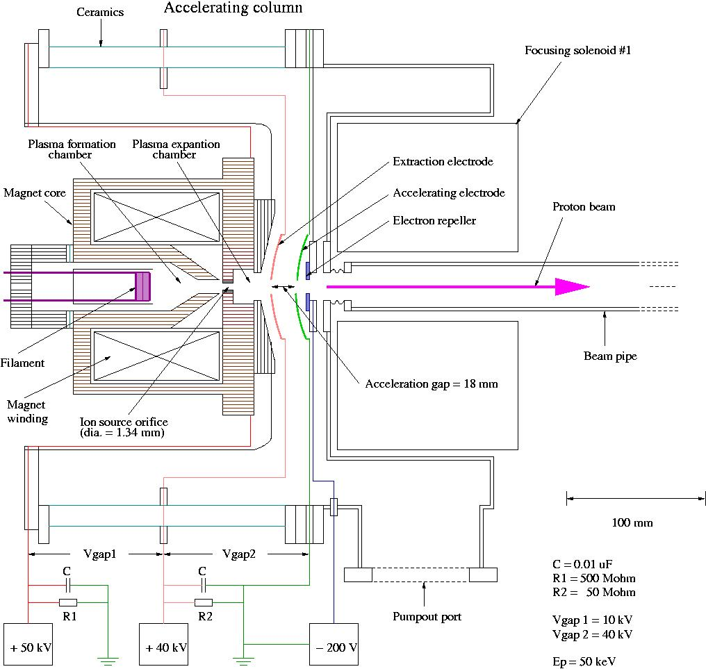
HINS Proton Source Arrangement*
HINS proton source is a re-configured,
and much improved Loma Linda Ion
Source (1989).
Major changes include:
Increased operational HV from 30 kV to 50 kV
Increased beam pulse duration from 65 μs @ 15 Hz to 3 ms @ 2.5 Hz (8 times higher beam power)
Installed new, 7 times stronger vacuum system
Installed digitally controlled supporting electronics for all ion source subsystems (HV, LV, H2 flow, vacuum, magnets, etc.)
Ion source operations are fully directed from HINS Main Console
*H. Piekarz

Slide 6
HINS Parameters for IOTA
matched to IOTA momentum, but β=.073!
Demonstrated for 1 ms pulses. Should go to >40 mA for short pulses. I recommend we assume that.
Is this big enough?
misreported as 2.
Why no one will steal this RFQ from us

Slide 7
Emittance issues
4 π-mm-mr is a very large emittance for this ring
Would be nice to go to a higher tune shift
This beam will scrape on the non-linear inserts
It’s hoped that the emmittance will be somewhat smaller for a short pulse, or we could scrape a 40 mA beam down to a lower emittance.
Recall, if you scrape in both planes
Could still go to unity tune shifts with half the emittance.
Most people (including me) forget this

Slide 8
HINS RFQ Layout for IOTA
We will initially use a protons source, and the same injection Lamberstson and kicker as the electrons
S. Antipov

Slide 9
RF System
The electrons will use a 1 kV, h=4, 30 MHz RF system.
For protons, this would be h=56, and 1 kV would only bunch ~1/3 of the protons (enough for BPMs)
Plan is to build a dual cavity, with an h=4 part for protons

Slide 10
Fermilab activities
Fermilab activities have focused primarily on the technical aspects of installing the proton source
The ion source, RFQ, and klystron were left in place, but all supporting hardware was cannibalized for PXIE (vacuum, HV, etc)
Very little money until FY17
Hope to resurrect ion source this year and RFQ next year in current location
Move to NML in FY17
Currently working on
Ion source refurbishment: Henryk Piekarz
Transfer line design: Sergei Antipov
RF system: Kermit Carlson
General engineering: Jerry Liebfritz
Vacuum (more demanding for protons): Lucy Nobrega
Synergia simulations: Eric Prebys
Instrumentation: Vic Scarpine and Randy Thurman-Keup

Slide 11
Lots of places for collaboration
Simulations
Cross-checks are important
Instrumentation
Still need a good way to measure profiles
Experimental program
What will we do with protons once we have them?
Improvements to source
What can we hope to get out of this?
Longer term upgrades
Ion injection?

Slide 12
Possible Future Upgrade: H- injection
Install a stripping foil in the 30° bend?
Still investigating bump configuration
Just a cartoon at this point. Not currently scoped.

Slide 13
Hope for this meeting
Who wants to do what?
Agree on standard set of starting assumption
Frequency/time of meetings (does this slot work?)

